Slide 1


LNG Potential for the Great Lakes Region Annual Meeting
May 21, 2014
Twin Cities Clean Cities Coalition May, 21, 2014
Lisa Thurstin

Slide 2
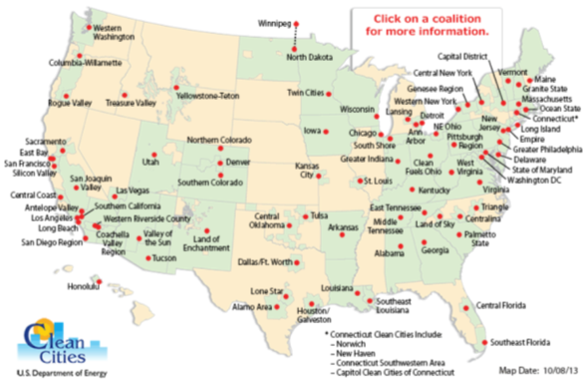

Coalition Background
1st in nation for
petroleum displacement
135 million gge 2005 - 2009
Twin Cities Clean Cities Coalition
Notes:
What is Clean Cities
When most people think of the Lung Association, they think of smoking cessation, asthma and other lung diseases.
But emissions from motorized vehicles are the single largest source of air pollution in Minnesota
The Lung Association understands the link between the vehicles we drive, the fuels we use, the air quality and our lung health.
Air pollutants can cause or exacerbate conditions such as asthma and chronic obstructive pulmonary disease.
Coalitions are made up of local and national stakeholders.
8,400 stakeholders nationwide
49% private-sector stakeholders
51% public-sector stakeholders
Clean Cities strategies to reduce petroleum use fall into three categories – replacement, reduction, and elimination.
Clean Cities provides a framework for coalitions to work within. The framework gives coordinators and stakeholders the flexibility to choose strategies that best meet their needs, take advantage of their available resources, and match their priorities.
Because Clean Cities coalitions employ multiple strategies to reduce petroleum use, they can adapt to changes in technologies and markets.
Since its inception in 1993, Clean Cities and its stakeholders have saved nearly 3 billion gallons of petroleum.
TC4 awards,
#1 ranking thanks to stakeholders being early adopters of alt fuels, supportive policy makers and innovative partnerships providing funding for infrastructure development
Coordinator of the year
2011 Hall of Fame
Hosted regional meetings and national meetings

Slide 3
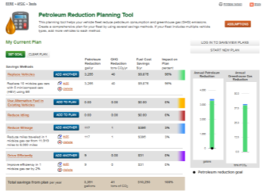
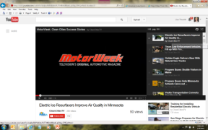
Benefits of TC4 Membership
Organizations that sign on as Clean Cities Stakeholders gain access to an array of resources, including:
  Information Resources
  Technical Assistance
  Technical Training & Workshops
  Funding Opportunities
  Public Recognition
  Assistance with Media Outreach
  And more…

Slide 4
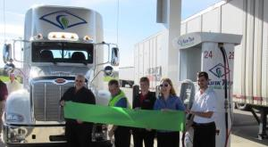
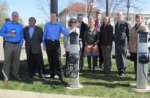
TC4 Stakeholders
Advanced Process Solutions
Andrews Inc. of Princeton
American Lung Association in MN
AmeriGas
Boyer Ford
Buesing Bulk Transport Inc
CenterPoint Energy
Chart Inc
CHS Inc.
City of Brooklyn Park
City of Duluth
City of Minneapolis
City of Oakdale
City of St. Paul
Clean N' Green Fuel
Como Oil & Propane
Commuter Connection
Dakota County
Eaton Corporation
Environmental Initiative
Ferrellgas
Ford Motor Company
G&K Services
General Motors
Grossman Chevrolet
Hennepin County
Holiday Companies
Kwik Trip
Minnesota BioFuels Association
Minnesota Corn Growers Association
MN Dept. of Administration - Travel Management
MN Department of Agriculture
Minnesota Office of Energy Security
Minnesota Pollution Control Agency
Minnesota Propane Association
MN Soybean Growers Association
Minnesota Valley Transit Authority
PlugInConnect
Ramsey County
Schwan's Ice Cream
United Soybean Board
U.S. Department of Energy National Clean Cities
U.S. General Services Administration
USPS Northland District
AJ Moses, private citizen
Notes:
Benefits of TC4 Membership
Promote your fleet success stories
Motorweek, stakeholder summit, case studies
Eligible for USDOE funding
Access to alternative fuel news, events, funding announcements
Webinars, Workshops, Training Opportunities
learning from and networking with other stakeholders, building partnerships
grant opportunities that favor Clean Cities stakeholders and collaborations, for example pending proposal for ev and ng preparedness.
- access to alt fuel news and funding announcements
- national recognition for fleets

Slide 5
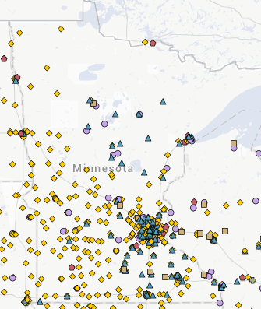

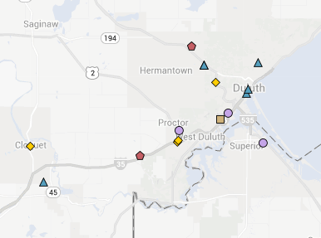
Alternative Fuels in Minnesota
523 Sites in MN
300 FlexFuel
11 Biodiesel
30 Propane
14 Natural Gas
168 EVSE
Alternative fuels in Duluth area

Slide 6
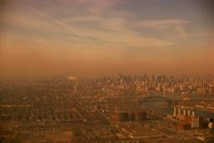
Clean Air Benefits of Alternative Fuels
Vehicle exhaust is the single largest source of air pollution in the state of Minnesota
Federal air quality standards for ozone are expected to tighten soon. Minnesota could soon be outside air quality guidelines
Regulation of greenhouse gas emissions is still possible – some say inevitable
Notes:
Alt fuels can play a significant role in reducing tailpipe emissions, especially when used in older vehicles or to replace older vehicles.
Overview of reduction emissions with alt fuels….
Biodiesel: Reduces greenhouse gas (GHG) emissions, Biodegradable and nontoxic, Cleaner-burning replacement for diesel fuel
E85 reduces greenhouse gas emissions: On a life-cycle basis, including fuel production and distribution, E85 made with corn ethanol reduces carbon greenhouse gas emissions by 19% to 52%, depending on the production process used. When E85 is made from cellulose materials, such as corn and wheat stalks or forestry waste, it can reduce greenhouse gases by 75%. E85 also reduces emissions of ozone formers and air toxics.
Natural gas: It is nontoxic, noncorrosive, and noncarcinogenic and presents no threat to soil, surface water, or groundwater.
Propane is a well-established, domestically available, clean-burning fuel. Propane is also known as liquefied petroleum gas (LPG), or autogas in Europe. Stored under pressure inside a tank, propane turns into a colorless, odorless liquid. As pressure is released, the liquid propane vaporizes and turns into gas that is used for combustion. An odorant, ethyl mercaptan, is added for leak detection. Unlike natural gas, propane is not a greenhouse gas (GHG) when released directly into the atmosphere. When considering the entire lifecycle of propane used in converted LDVs, Argonne National Lab found that propane reduced GHG emissions by 21% to 24%.

Slide 7
Change In The Air
Minnesota is close to non-attainment under the Clean Air Act for ozone and fine particulates
Direct economic impact to Minnesota for non-attainment in these two areas would be $140 - $240 million per year.
Non-attainment would result in a 5-year mitigation plan that could impose a variety of regulatory requirements.

Slide 8
Change In The Air
Sources of NOX, VOCs and/or fine particulates (PM2.5) could be regulated.
Regulations in other communities include:
  Vehicle emissions testing
  Reformulated gasoline
  Variety of other regulations
Notes:
Clean Air Minnesota Goals
Identify, evaluate, and prioritize strategies to reduce air pollution.
Develop, fund, and implement projects to improve air quality.
Track emissions reductions achieved and report those reductions to the wider community on a regular basis.
The goal of this effort is to translate ideas into air quality projects that yield measurable emissions reductions that will benefit our environment and the health of all Minnesotans.
The goal of this effort is to translate ideas into air quality projects that yield measurable emissions reductions that will benefit our environment and the health of all Minnesotans.

Slide 9
Current Projects
Twin Cities Clean Cities Coalition & Mississippi National River and Recreation Area
Clean Cities/National Parks Partnership
12 EVSE at 11 sites
Grand opening event
Completion estimated July 2014
Partners include:
City of Ramsey
City of Saint Paul
Fort Snelling State Park
Minneapolis Park & Rec Board
Mississippi National River and Recreation area
MN Historical Society
MN Pollution Control Agency
Science Museum of Minnesota
Three Rivers Parks District
Twin Cities Clean Cities Coalition
Notes:
Other partners include:
MN Pollution Control Agency
National Park Service
Mississippi National River and Recreation Area
USDOE/NREL

Slide 10
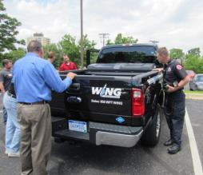
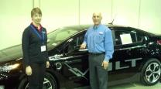

Current Projects cont.
Accelerating Alternatives for Minnesota Drivers
Clean Cities - Implementation Initiatives to Advance
Alternative Fuel Markets FOA: DE-FOA-0000708
Completion January, 2015
Project deliverables include:
  Alternative fuel & vehicle first responder safety trainings
  Develop a natural gas vehicle workgroup
  Establish a MN green fleet recognition program
  Further the deployment of electric & natural gas vehicles
  Multi-Unit Housing tools and website
Twin Cities Clean Cities Coalition

Slide 11
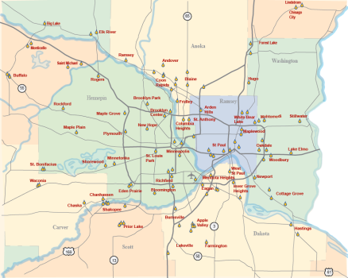
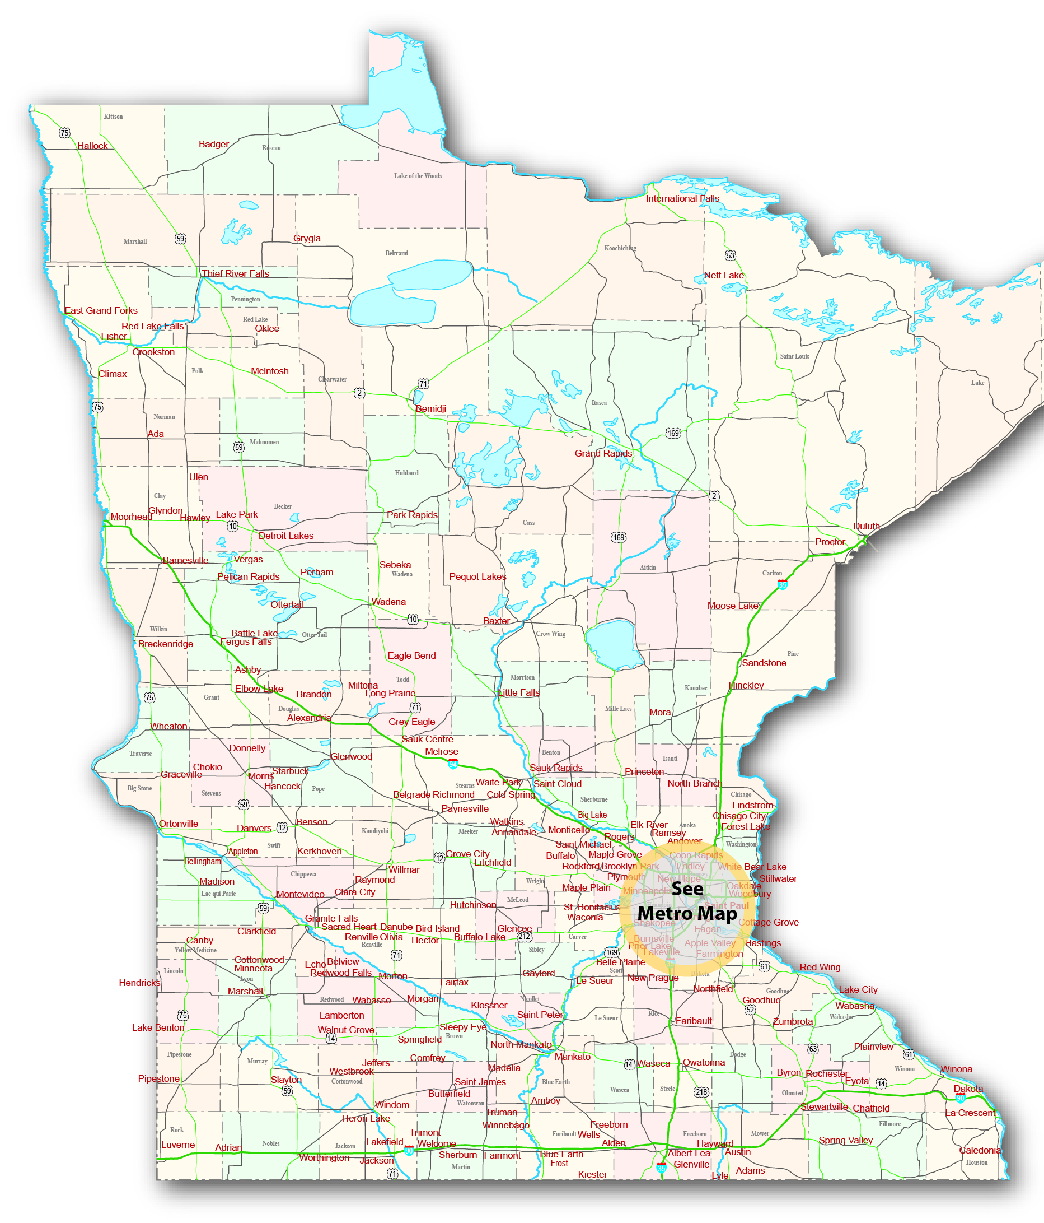
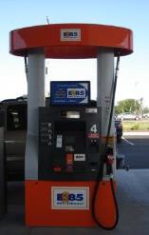
Current Projects cont.
Infrastructure Grant Programs
300 E85 retailers; 78 with flex pumps offering E20, E30 and/or E50; 7 sites offer E15
Twin Cities Clean Cities Coalition
Notes:
E85/Flex Pump Development Program
Administer infrastructure grant program for flex pump configurations blending E10 & E85 to mid-level ethanol blends, including E15 whenever possible.
Increase use of these fuels through grassroots education and marketing to motorists, fleets, policy makers, and media, supporting the benefits and operability of these fuels.
Personnel & funding focused on:
Securing retailers
Assisting retailers with grants
Assisting in technical, marketing & trouble-shooting
Build consumer awareness

Slide 12
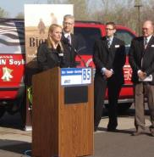
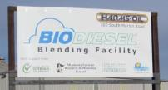

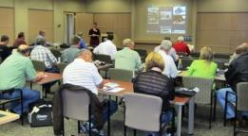
Current Projects cont.
Biodiesel market development
Support Minnesota’s increase to higher biodiesel blends statewide
    TC4 staff sits on Biodiesel Task Force
    Hosting biodiesel workshops for fleets and fuel retailers
    Expanding infrastructure through grants
Educating the next generation on biodiesel
  Biodiesel Poster 5th & 6th grade students
    Started in 2013
    7 schools
  Essay Scholarship Contest for high school seniors
    Started in 2007
    455 students have submitted essays to date
Twin Cities Clean Cities Coalition

Slide 13
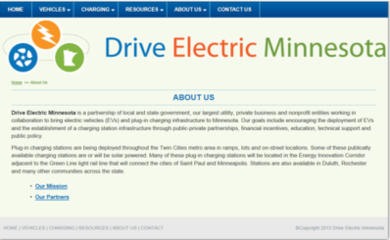
Current Projects cont.
Drive Electric Minnesota
Mission: To encourage the deployment of EVs and the establishment of plug-in charging infrastructure through public-private partnerships, financial incentives, education, technical support, and public policy. To advance electric vehicle deployment to reduce transportation costs, improve air quality and create energy independence for Minnesotans.
49 public and private partners
Installed more than 120 EVSE
Zero Emissions Charging Challenge
Charge While You Work – guide
Meets quarterly at TC4 office
Twin Cities Clean Cities Coalition

Slide 14
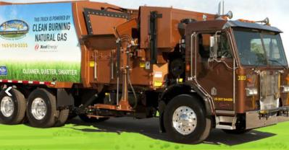
Current Projects cont.
Minnesota Natural Gas Vehicle Coalition
Mission: To accelerate the deployment of natural gas vehicles (NGVs) in public/private fleets and expand the infrastructure in Minnesota in order to reduce transportation costs and improve air quality for Minnesotans.
Formed through funding of USDOE AAMD grant
Meets quarterly at TC4 office
80+ public and private stakeholders
Creating case studies, resource pages,
workshops, ride & drives
Twin Cities Clean Cities Coalition

Slide 15
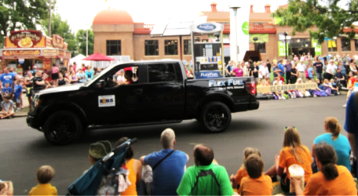
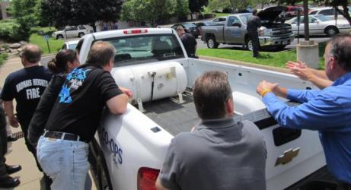
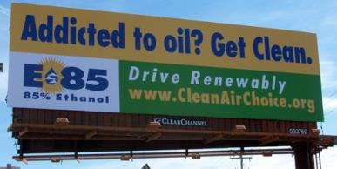
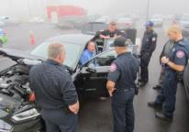
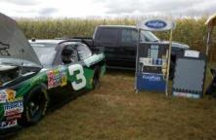
Outreach and Education
Strategies cont.
Twin Cities Clean Cities Coalition

Slide 16
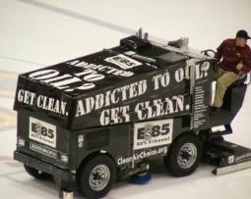
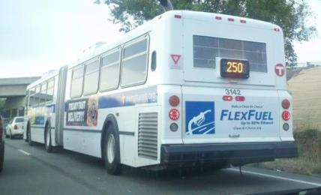
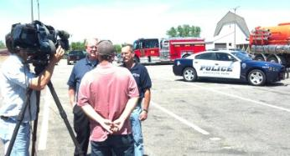
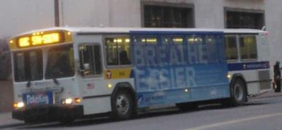
Outreach and Education
Strategies cont.
Zamboni Sponsorships
Vehicle Wraps
Bus tails/sides
MotorWeek
Twin Cities Clean Cities Coalition
Notes:
Bus Tails
50 Twin Cities Metro Transit August December, 2012
4+ million impressions
Grassroots Education in Minnesota
Direct mail to flex fuel vehicle owners
Promotional events (grand openings & frequent fuel cards)
Trade shows & conferences/speaking opportunities
Working with fleets
Working with dealerships
Paid, earned and social media:
Facebook – Clean Air Choice Team
Twitter - @CleanAirChoice2
Website & E85 Price Forum
www.CleanAirChoice.org

Slide 17
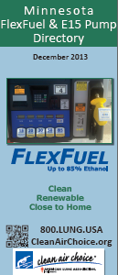

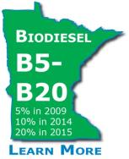

Tools to Accelerate Alternative
Fuel Use in Minnesota
Idle reduction tools
IdleBox Tools
Policies
Enforcement
What vehicles are in your fleet
Flex fuel vehicles – E85
Diesel – biodiesel (B5-B20)
Volts – electric
Bus passes & parking
Subsidize carpool parking
Subsidize bus passes
Telecommuting Policies
Electric vehicle tools
Workplace Charging
Nissan Corporate Program
Multi-Unit Housing Tools
Public natural gas site
Waste haulers
Taxis
Shuttles
Twin Cities Clean Cities Coalition

Slide 18
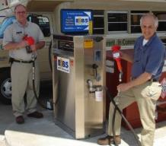
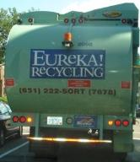
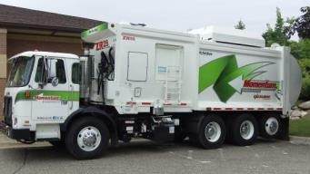
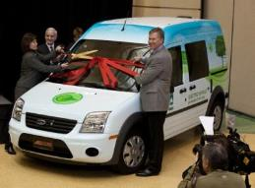
Questions?
Lisa Thurstin
Twin Cities Clean Cities Coalition
CleanAirChoice.org 651.223.9568
Lisa.Thurstin@Lung.org
Twitter: @CleanAirChoice2
Facebook: Clean Air Choice Team
Lorrie Lisek
Wisconsin Clean Cities, Inc.
Milwaukee, WI 53203
Office (414)221-4958
lorrie.lisek@wicleancities.org
www.wicleancities.org
Twin Cities Clean Cities Coalition

